Slide 1
Prediction of Mental Health Using Machine Learning
Guided By
Dr. M.Sreelatha
Prof. & HOD
Dept. of CSE
Team Members:-
B.Sushma Sri(Y18CS016)
D.Sri Harsha Chowdary(Y18CS034)
A.Chanikya Subhash(Y18CS003)

Slide 2
Table of Contents
Abstract
Introduction
Index Terms
Literature Review
Data Set
Workflow
Proposed Model
Results
Conclusion

Slide 3
ABSTRACT
Interpretation public emotional wellness concerns utilizing data science and observing arrangements dependent on the discoveries from the data science tasks can be complicated and requires progressed methods, contrasted with regular data investigation projects.
Have an extensive task the executive’s interaction to guarantee that undertaking partners are capable and have sufficient information to carry out the data science procedure.
Thus, this paper describes another structure that psychological wellness experts be able to use to address difficulties they realize utilizing data science.
Albeit countless exploration papers have been distributed on open emotional well-being, few have tended to the utilization of data science in open psychological wellness.

Slide 4
ABSTRACT
As of late, data science has altered the manner in which we oversee, investigate and influence data in medical care industry.
High prevalence of mental health and the need for effective mental fitness care, blended with current advances in AI, has led to a growth in explorations of ways the sphere of system getting to know Machine Learning can assist inside the detection, prognosis and treatment of mental health issues.

Slide 5
INTRODUCTION
Mental illness denotes all diagnosable mental disorders which are characterized by irregularities in reasoning, sentiments, or practices.
Psychological maladjustment is extremely normal and causes generous social and financial weight around the world, yet no standardized biological diagnostic tests are available, and the analysis is as yet reliant upon clinical abilities and well-qualified assessment.

Slide 6
INTRODUCTION
Mental health is vital for overall well-being of human. Mental prosperity is significant for personal satisfaction and the capacity to adapt to information to day life.
Mental illness can have a huge impact on and correlation with physical illness.
Along with medical terms, data management parameters are analyzed in the experimental section to emphasize the proposed work performance.

Slide 7
INDEX TERMS
Psychological Health
Machine Learning
Visual Data Exploration
Data Science

Slide 8
Literature Review
Machine learning in mental health: a scoping review of methods and applications
It aims to synthesize the literature on machine learning (ML) and big data applications for mental health.
A scoping review methodology to rapidly map the field of ML in mental health. Eight health and information technology research databases.
The application of ML to mental health has demonstrated a range of benefits across the areas of diagnosis, treatment and support, research, and clinical administration.
With the majority of studies identified focusing on the detection and diagnosis of mental health conditions, it is evident that there is significant room for the application of ML to other areas of psychology and mental health. The challenges of using ML techniques are discussed, as well as opportunities to improve and advance the field.

Slide 9
Literature Review
Predicting anxiety and depression in elderly patients using machine learning technology
Anxiety and depression are two important mental health problems among the geriatric population. They are often undiagnosed and directly or indirectly responsible for various morbidities.
Early and timely diagnosis has immense effect on appropriate management of anxiety and depression along with its co-morbidities.
It is of utmost importance to develop a predictive model for automated diagnosis of anxiety and depression among them.
Aims to develop an appropriate predictive model, to diagnose anxiety and depression among older patient from socio-demographic and health-related factors, using machine learning technology.

Slide 10
Literature Review
Predicting anxiety and depression in elderly patients using machine learning technology
Classifiers were evaluated with a data set of 510 geriatric patients and tested with ten-fold cross-validation method. Highest prediction accuracy of 89% was obtained with random forest (RF) classifier.
This RF model was tested with another data set from separate 110 older patients for its external validity. Its predictive accuracy was found to be 91% and false positive (FP) rate was 10%, compared with gold standard tool.

Slide 11
Literature Review
Validating Machine Learning Algorithms for Twitter Data Against Established Measures of Suicidality
One of the leading causes of death in the United States (US) is suicide and new methods of assessment are needed to track its risk in real time.
The objective is to validate the use of machine learning algorithms for Twitter data against empirically validated measures of suicidality in the US population.
Using a machine learning algorithm, the Twitter feeds of 135 Mechanical Turk (MTurk) participants were compared with validated, self-report measures of suicide risk.
Findings show that people who are at high suicidal risk can be easily differentiated from those who are not by machine learning algorithms, which accurately identify the clinically significant suicidal rate in 81% of cases

Slide 12
Literature Review
Using the Depression Anxiety Stress Scale 21 (DASS-21) across cultures
The DASS-21 is a well-established instrument for measuring depression, anxiety, and stress with good reliability and validity reported from Hispanic American, British, and Australian adults.
However, the lack of appropriate validation among Asian populations continues to pose concerns over the use of DASS-21 in Asian samples. Cultural variation may influence the individual's experience and emotional expression.
Thus, when researchers and practitioners employ Western-based assessments with Asian populations by directly translating them without an appropriate validation, the process can be challenging.
Conducted a series of rigorous statistical tests and minimized any potential confounds from the demographic information.

Slide 13
Literature Review
Using the Depression Anxiety Stress Scale 21 (DASS-21) across cultures
Following factor analyses, performed multigroup analysis across six nations to demonstrate consistency of our findings.
The advantages of this revised DASS-18 stress scale are twofold. First, it possesses fewer items, which results in a cleaner factorial structure. Second, it has a smaller interfactor correlation.
With these justifications, the revised DASS-18 stress scale is potentially more suitable for Asian populations. Nonetheless, given limitations, findings should be considered preliminary.

Slide 14
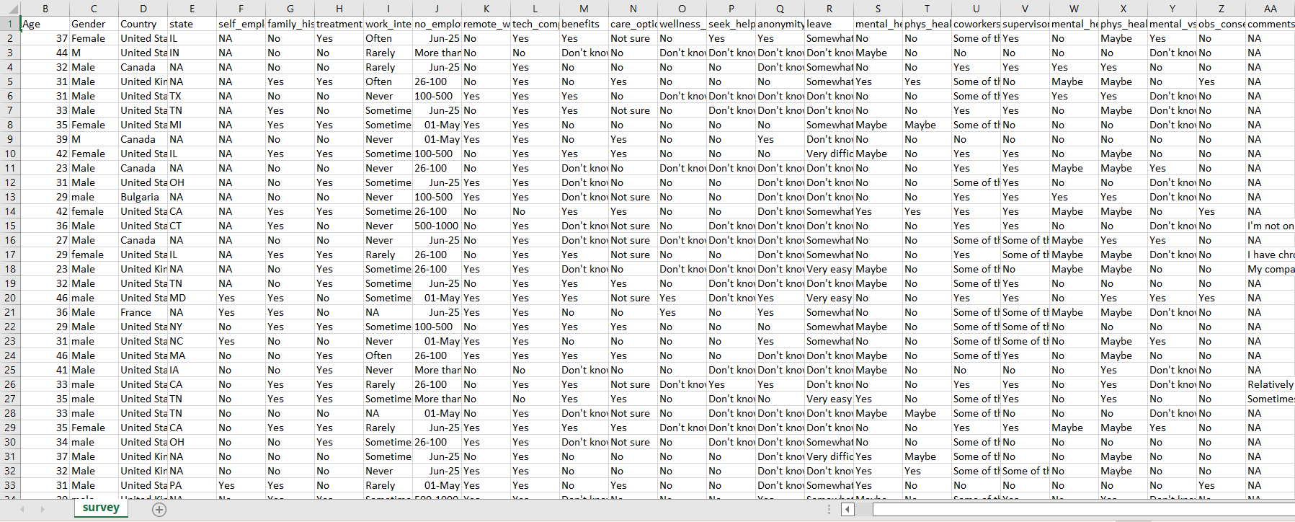
Dataset

Slide 15
Dataset
Dataset consists of 1259 tuples and 26 attributes with different age, gender and place of the person he/she live etc..,
All the attributes have its own dependency with the mental health of the person.
By using all the attributes, we can decide mental health of the person.

Slide 16
Workflow
1. LIBRARY AND DATA LOADING
2. DATA CLEANING
3. ENCODING DATA
4. COVARIANCE MATRIX. VARIABILITY COMPARISON BETWEEN CATEGORIES OF VARIABLES
5. SOME CHARTS TO SEE DATA RELATIONSHIP
6. SCALING AND FITTING
7. TUNING

Slide 17
Workflow
8. EVALUATING MODELS
A. Logistic Regression
B. KNeighbors Classifier
C. Decision Tree Classifier
D. Random Forests
E. Bagging
F. Boosting
G. Stacking

Slide 18
Workflow
9. SUCCESS METHOD PLOT
10. CREATING PREDICTIONS ON TEST SET

Slide 19
Methodology
Alogorithms Used:
KNN
Random Forest
Logistic Regression
Decision Tree
Bagging
Boosting
Stacking

Slide 20
Proposed Model Algorithms KNN:
K-Nearest Neighbor is one of the top Machine Learning calculations fundamentally dependent on Supervised Learning strategy.
K-NN calculation stores every one of the accessible information and characterizes another information point dependent on the comparability.
This implies when new information shows up then it tends to be effectively grouped into a well suite class by utilizing K-NN calculation.

Slide 21
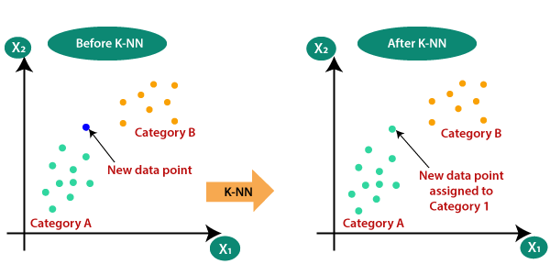
Proposed Model Algorithms KNN:

Slide 22
Proposed Model Algorithms Random Forest:
Random forest is a Supervised Machine Learning Algorithm that is used widely in Classification and Regression problems.
It builds decision trees on different samples and takes their majority vote for classification and average in case of regression.
One of the most important features of the Random Forest Algorithm is that it can handle the data set containing continuous variables as in the case of regression and categorical variables as in the case of classification. It performs better results for classification problems.

Slide 23
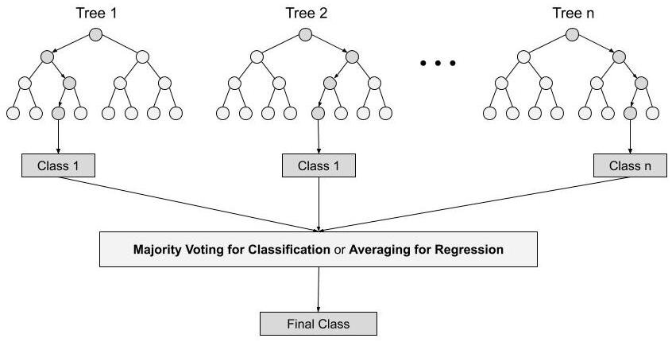
Proposed Model Algorithms Random Forest:

Slide 24
Proposed Model Algorithms Logistic Regression:
Logistic Regression is a Machine Learning algorithm which is used for the classification problems
It is used for predicting the categorical dependent variable using a given set of independent variables.
The hypothesis of logistic regression tends it to limit the cost function between 0 and 1. Therefore linear functions fail to represent it as it can have a value greater than 1 or less than 0 which is not possible as per the hypothesis of logistic regression.

Slide 25
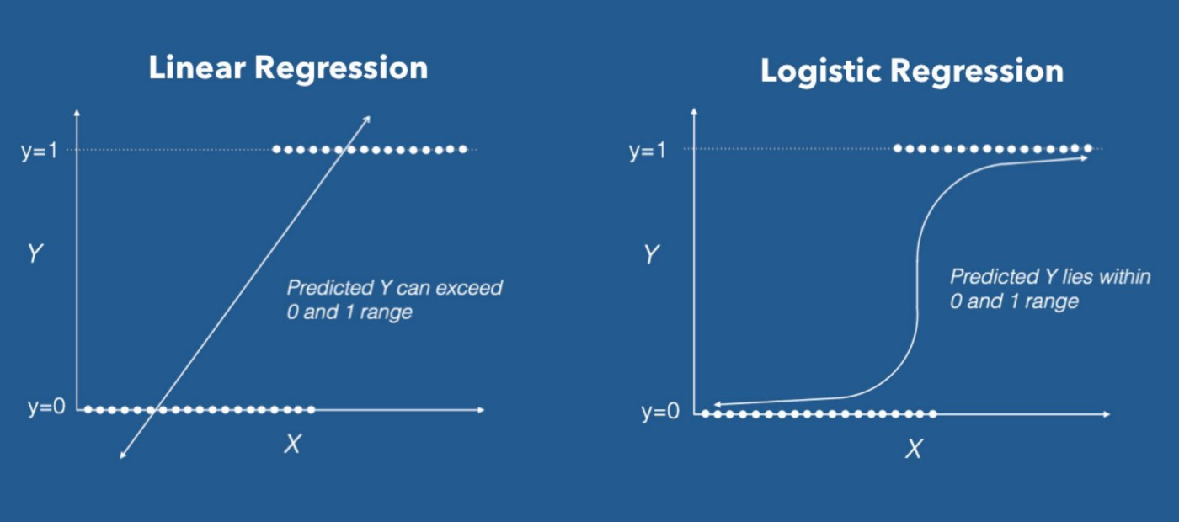
Proposed Model Algorithms Logistic Regression:

Slide 26
Proposed Model Algorithms Decision Tree:
A decision tree is a flowchart-like structure in which each internal node represents a test on a feature, each leaf node represents class label. and branches represent conjunctions of features that lead to those class labels. The paths from root to leaf represent classification rules.
Decision Trees are a non-parametric supervised learning method used for both classification and regression tasks.
Tree models where the target variable can take a discrete set of values are called classification trees. Decision trees where the target variable can take continuous values (typically real numbers) are called regression trees.

Slide 27

Proposed Model Algorithms Decision Tree:

Slide 28
Proposed Model Algorithms Ada Boost:
AdaBoost algorithm, short for Adaptive Boosting, is a Boosting technique that is used as an Ensemble Method in Machine Learning.
It is called Adaptive Boosting as the weights are re-assigned to each instance, with higher weights to incorrectly classified instances.
Boosting is used to reduce bias as well as the variance for supervised learning. It works on the principle where learners are grown sequentially.
Except for the first, each subsequent learner is grown from previously grown learners. In simple words, weak learners are converted into strong ones.

Slide 29
Prediction of Mental Health Using Machine Learning
Review 2
Guided By
Dr. M.Sreelatha
Prof. & HOD
Dept. of CSE
Team Members:-
B.Sushma Sri(Y18CS016)
D.Sri Harsha Chowdary(Y18CS034)
A.Chanikya Subhash(Y18CS003)

Slide 30
Table of Contents
Dataset Description
Architecture
Proposed Model
Implementation and Results Discussion

Slide 31
Dataset Description
Dataset consists of 1260 tuples and 27 attributes.
All the attributes have its own dependency with the mental health of the person.
By using all the attributes, we can decide mental health of the person.
Timestamp: Time the survey was submitted
Age: Respondent age
Gender: Respondent gender
Country: Respondent country ( Most of respondents from US,UK)
State: If you live in the United States, which state or territory do you live in?
Self_employed: Are you self-employed?(Yes/No)

Slide 32
Dataset Description
Family_history: Do you have a family history of mental illness?
Treatment: Have you sought treatment for a mental health condition?
Work_interfere: If you have a mental health condition, do you feel that it interferes with your work? (Sometimes/Rarely/Yes/No)
No_employees: How many employees does your company or organization have?
Remote_work: Do you work remotely (outside of an office) at least 50% of the time?
Tech_company: Is your employer primarily a tech company/organization?
Benefits: Does your employer provide mental health benefits?

Slide 33
Dataset Description
Care_options: Do you know the options for mental health care your employer provides?
Wellness_program: Has your employer ever discussed mental health as part of an employee wellness program?
Seek_help: Does your employer provide resources to learn more about mental health issues and how to seek help?
Anonymity: Is your anonymity protected if you choose to take advantage of mental health or substance abuse treatment?
Leave: How easy is it for you to take medical leave for a mental health condition?
mental_health_consequence: Do you think that discussing a mental health issue with your employer would have negative consequences?

Slide 34
Dataset Description
phys_health_consequence: Do you think that discussing a physical health issue with your employer would have negative consequences?
Coworkers: Would you be willing to discuss a mental health issue with your coworkers?
Supervisor: Would you be willing to discuss a mental health issue with your direct supervisor(s)?
mental_health_interview : Would you bring up a mental health issue with a potential employer in an interview?
physical_health_interview : Would you bring up a physical health issue with a potential employer in an interview?
Mental_vs_physical: Do you feel that your employer takes mental health as seriously as physical health?

Slide 35
Dataset Description
Obs_consequence: Have you heard of or observed negative consequences for coworkers with mental health conditions in your workplace?
Comments: Any additional notes or comments

Slide 36
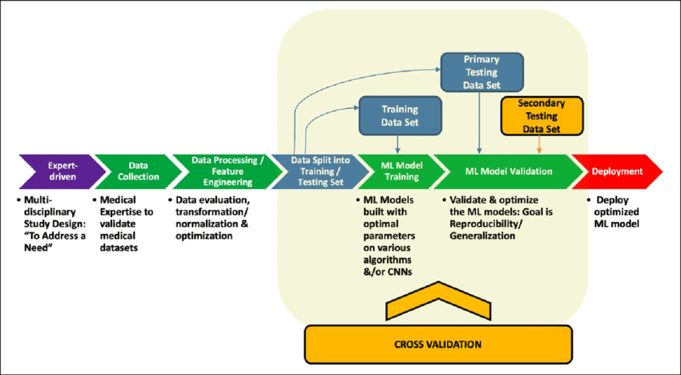
Architecture

Slide 37
Workflow
1. LIBRARY AND DATA LOADING
2. DATA CLEANING
3. ENCODING DATA
4. COVARIANCE MATRIX. VARIABILITY COMPARISON BETWEEN CATEGORIES OF VARIABLES
5. SOME CHARTS TO SEE DATA RELATIONSHIP
6. SCALING AND FITTING
7. TUNING

Slide 38
Workflow
8. EVALUATING MODELS
A. Logistic Regression
B. KNeighbors Classifier
C. Decision Tree Classifier
D. Random Forests
E. Bagging
F. Boosting
G. Stacking

Slide 39
Workflow
9. SUCCESS METHOD PLOT
10. CREATING PREDICTIONS ON TEST SET
11. CONCLUSIONS

Slide 40
Proposed Model
Preprocessing:
Data preprocessing is a process of preparing the raw data and making it suitable for a machine learning model. It is the first and crucial step while creating a machine learning model.
A real-world data generally contains noises, missing values, and maybe in an unusable format which cannot be directly used for machine learning models.
Data preprocessing is required tasks for cleaning the data and making it suitable for a machine learning model which also increases the accuracy and efficiency of a machine learning model.
Preprocessing of raw data is the integral step in the proposed pipeline, as the quality of data can drive the classifiers to learn directly.

Slide 41
Proposed Model
Preprocessing:
In the proposed framework, the preprocessing step includes
Outlier rejection
Data Cleaning
Filling missing values
Encoding Data

Slide 42
Proposed Model Algorithms KNN:
K-Nearest Neighbor is one of the top Machine Learning calculations fundamentally dependent on Supervised Learning strategy.
K-NN calculation stores every one of the accessible information and characterizes another information point dependent on the comparability.
This implies when new information shows up then it tends to be effectively grouped into a well suite class by utilizing K-NN calculation.

Slide 43
Proposed Model Algorithms KNN:

Slide 44
Proposed Model Algorithms Random Forest:
Random forest is a Supervised Machine Learning Algorithm that is used widely in Classification and Regression problems.
It builds decision trees on different samples and takes their majority vote for classification and average in case of regression.
One of the most important features of the Random Forest Algorithm is that it can handle the data set containing continuous variables as in the case of regression and categorical variables as in the case of classification. It performs better results for classification problems.

Slide 45
Proposed Model Algorithms Random Forest:

Slide 46
Proposed Model Algorithms Logistic Regression:
Logistic Regression is a Machine Learning algorithm which is used for the classification problems
It is used for predicting the categorical dependent variable using a given set of independent variables.
The hypothesis of logistic regression tends it to limit the cost function between 0 and 1. Therefore linear functions fail to represent it as it can have a value greater than 1 or less than 0 which is not possible as per the hypothesis of logistic regression.

Slide 47
Proposed Model Algorithms Logistic Regression:

Slide 48
Proposed Model Algorithms Decision Tree:
A decision tree is a flowchart-like structure in which each internal node represents a test on a feature, each leaf node represents class label. and branches represent conjunctions of features that lead to those class labels. The paths from root to leaf represent classification rules.
Decision Trees are a non-parametric supervised learning method used for both classification and regression tasks.
Tree models where the target variable can take a discrete set of values are called classification trees. Decision trees where the target variable can take continuous values (typically real numbers) are called regression trees.

Slide 49
Proposed Model Algorithms Decision Tree:

Slide 50
Proposed Model Algorithms Bagging:
The idea behind bagging is combining the results of multiple models (for instance, all decision trees) to get a generalized result. Here’s a question: If you create all the models on the same set of data and combine it, will it be useful? There is a high chance that these models will give the same result since they are getting the same input. So how can we solve this problem? One of the techniques is bootstrapping.
Bootstrapping is a sampling technique in which we create subsets of observations from the original dataset, with replacement. The size of the subsets is the same as the size of the original set.
Bagging (or Bootstrap Aggregating) technique uses these subsets (bags) to get a fair idea of the distribution (complete set). The size of subsets created for bagging may be less than the original set.

Slide 51
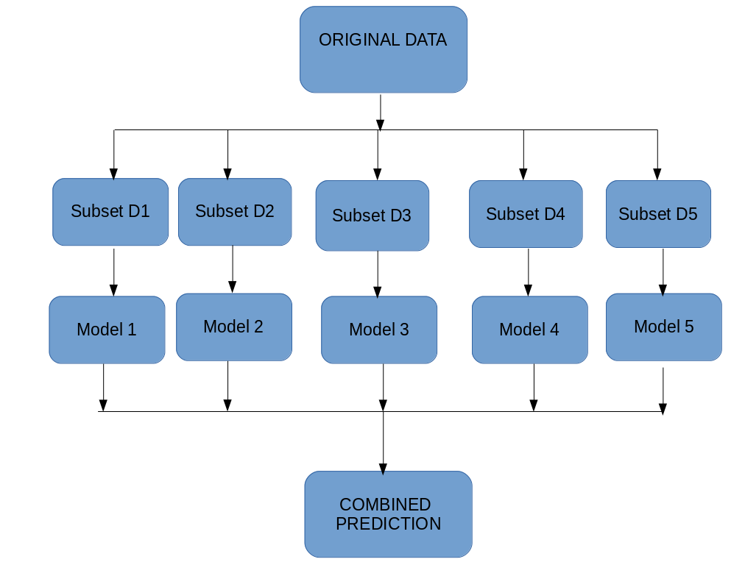
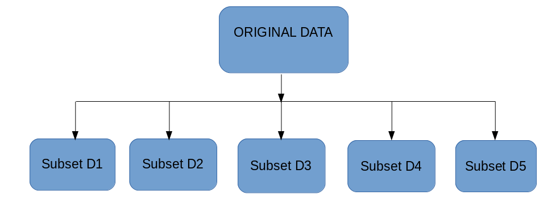
Proposed Model Algorithms Bagging:

Slide 52
Proposed Model Algorithms Bagging:
Multiple subsets are created from the original dataset, selecting observations with replacement.
A base model (weak model) is created on each of these subsets.
The models run in parallel and are independent of each other.
The final predictions are determined by combining the predictions from all the models

Slide 53
Proposed Model Algorithms Boosting:
If a data point is incorrectly predicted by the first model, and then the next (probably all models), will combining the predictions provide better results? Such situations are taken care of by boosting.
Boosting is a sequential process, where each subsequent model attempts to correct the errors of the previous model. The succeeding models are dependent on the previous model. Let’s understand the way boosting works in the below steps.
A subset is created from the original dataset.
Initially, all data points are given equal weights.
A base model is created on this subset.

Slide 54
Proposed Model Algorithms Boosting:
This model is used to make predictions on the whole dataset.
Errors are calculated using the actual values and predicted values.
The observations which are incorrectly predicted, are given higher weights. (Here, the three misclassified blue-plus points will be given higher weights)
Another model is created and predictions are made on the dataset. (This model tries to correct the errors from the previous model)
Similarly, multiple models are created, each correcting the errors of the previous model.
The final model (strong learner) is the weighted mean of all the models (weak learners)

Slide 55
Proposed Model Algorithms Stacking:
Stacking is an ensemble learning technique that uses predictions from multiple models (for example decision tree, knn or svm) to build a new model. This model is used for making predictions on the test set. Below is a step-wise explanation for a simple stacked ensemble:
The train set is split into 10 parts
A base model (suppose a decision tree) is fitted on 9 parts and predictions are made for the 10th part. This is done for each part of the train set.
The base model (in this case, decision tree) is then fitted on the whole train dataset.
Using this model, predictions are made on the test set.
Steps 2 to 4 are repeated for another base model (say knn) resulting in another set of predictions for the train set and test set.

Slide 56
Proposed Model Algorithms Stacking:
The predictions from the train set are used as features to build a new model.
This model is used to make final predictions on the test prediction set.

Slide 57
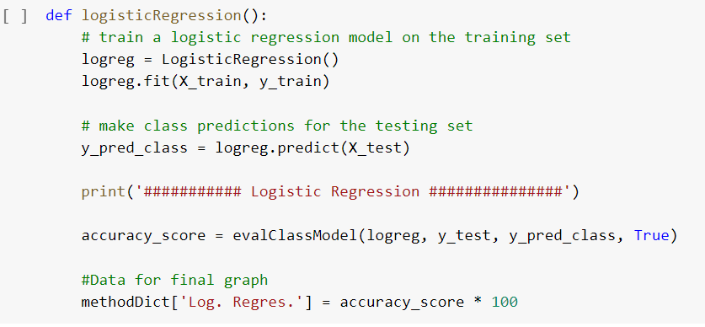
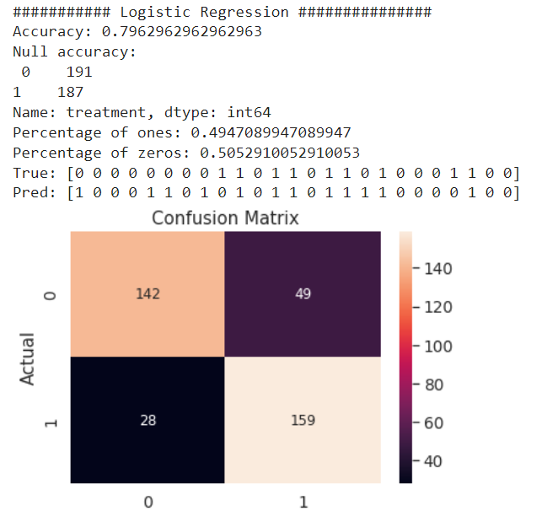
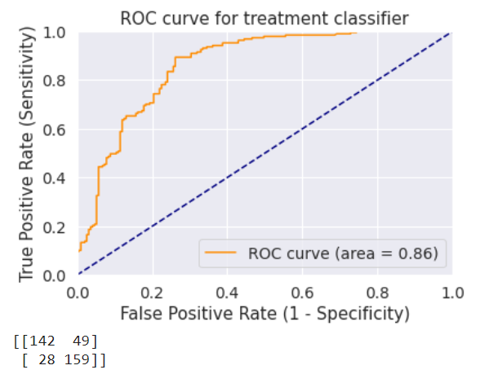
Implementation and Result Discussion Logistic Regression

Slide 58
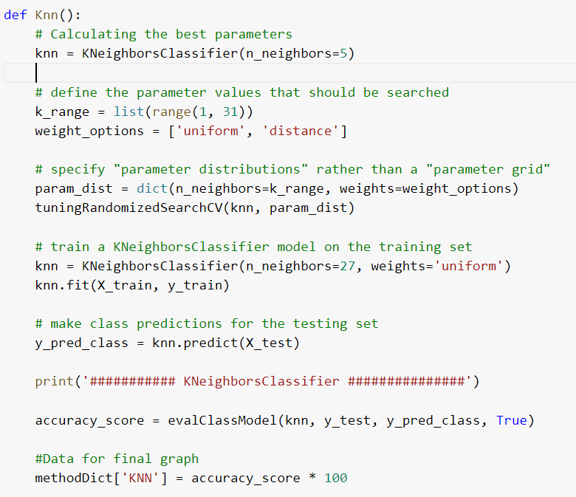
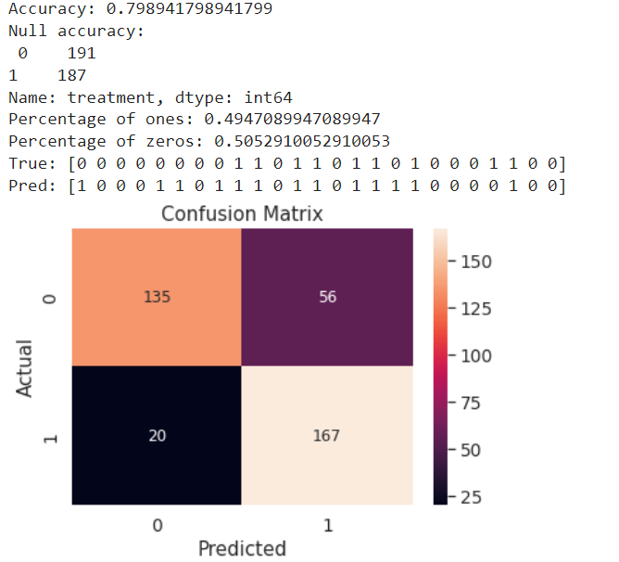
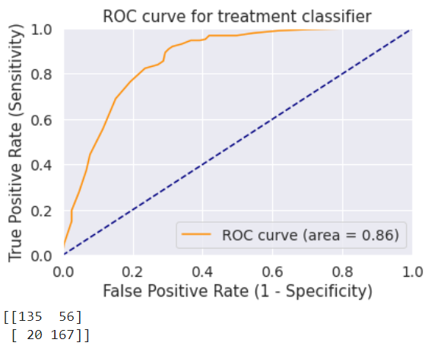
Implementation and Result Discussion KNN

Slide 59
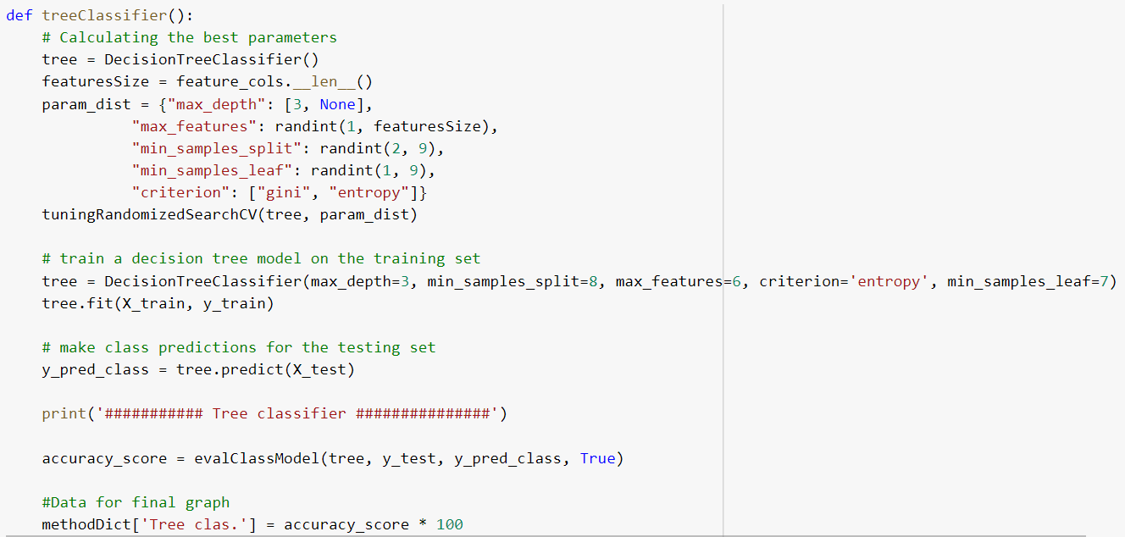
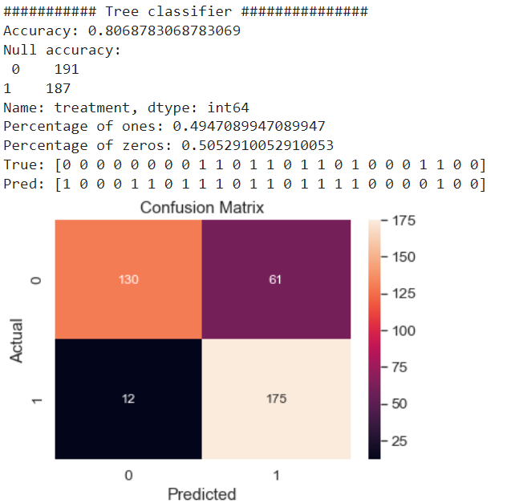
Implementation and Result Discussion Decision Tree

Slide 60
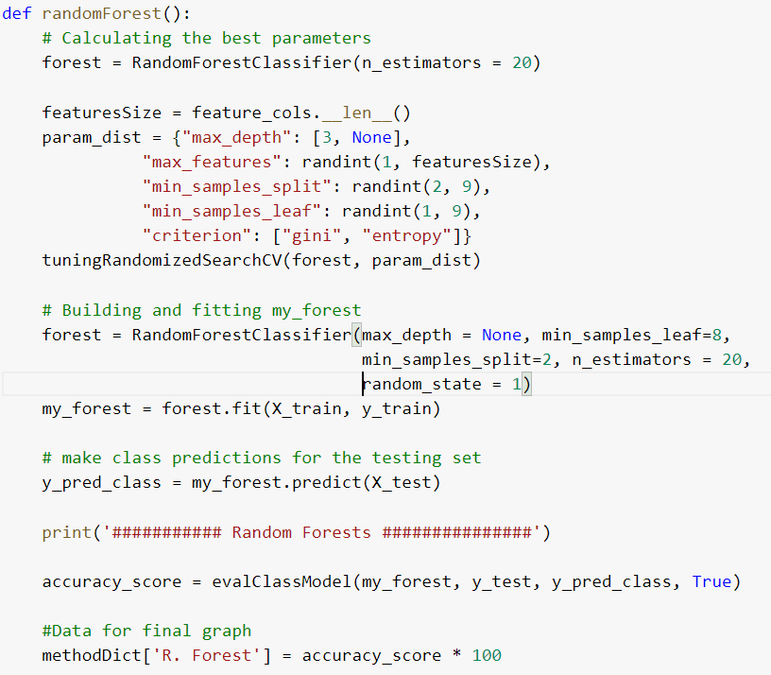
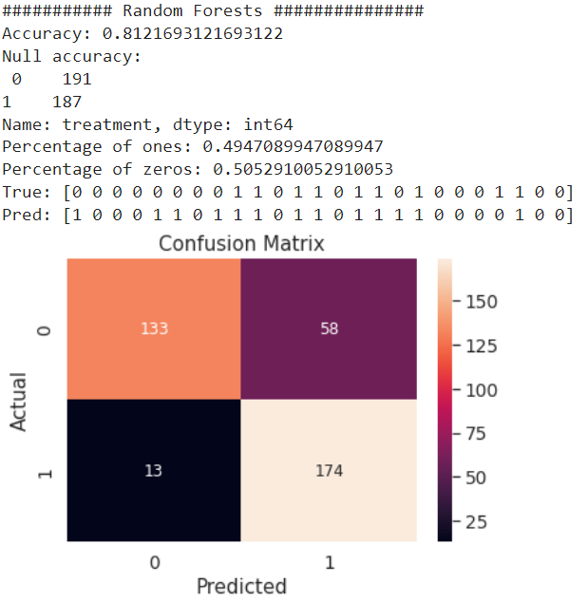
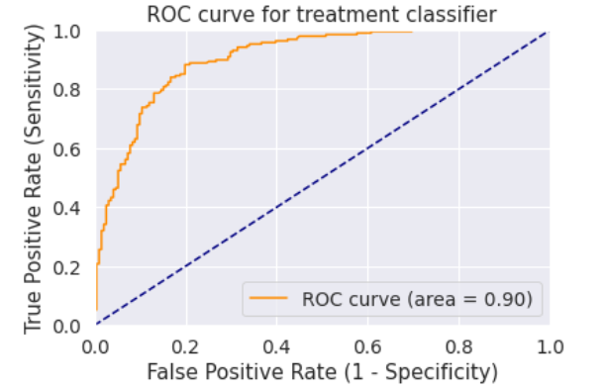
Implementation and Result Discussion Random Forest

Slide 61
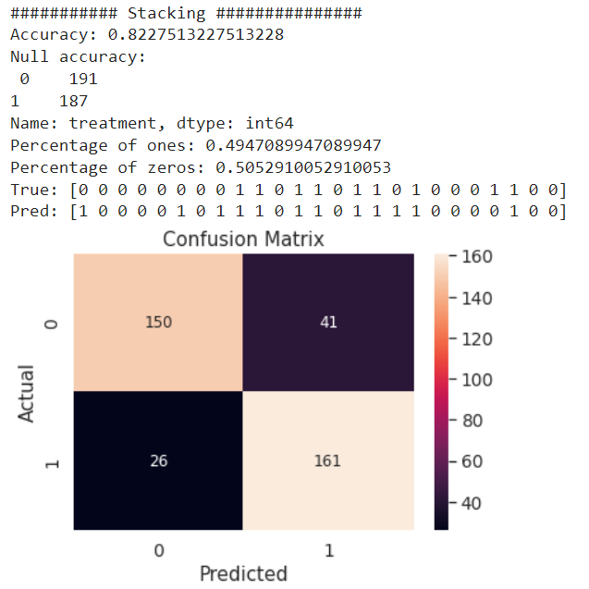
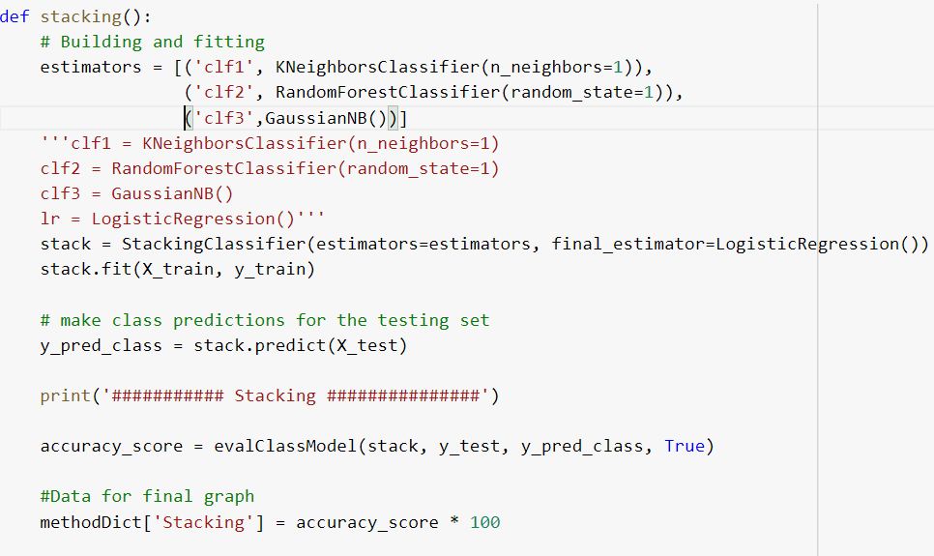
Implementation and Result Discussion Stacking

Slide 62
Conclusion
Understanding public intellectual health troubles and find solution can be complicated and requires advanced techniques, as compared to standard facts analysis tasks. Data Science in healthcare is an evolving subject of amazing significance to supply a projection and deeper information of disorder category, specifically in mental health.
For this reason, it is essential to have a data science project management process to ensure that project participants are competent and have enough knowledge to start and progress the project successfully. The main objective of this project is to present a new structure that mental health professionals can use to solve challenges using data science and machine learning.

Slide 63


